Slide 1
Types of Data
The term variable means a quality or quantity which varies from one member of a sample or population to another.
Systolic blood pressure is a variable, which varies both from person to person & from measurement to measurement within the same person.

Slide 2
Sex is a variable, people being either male or female.
The collection of observations or measurements on a variable characteristic defined on the units of a population or a sample selected from it are called data.

Slide 3
It is useful to think of data as being of several different types, as the type of data is important in deciding which methods of presentation & analysis we should adopt.
Data can be one of two types:
Qualitative Data
Quantitative Data

Slide 4
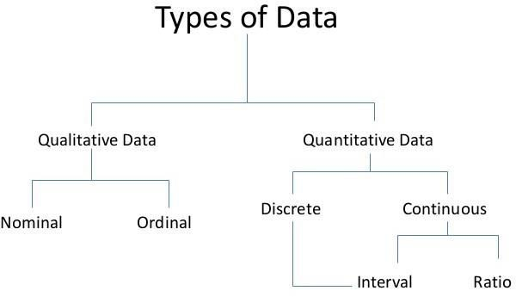

Slide 5
Qualitative Data:
Qualitative data arise when individuals may fall into separate classes, such as diagnosis or sex.
A qualitative variable is also termed a categorical variable or a classification variable.
Qualitative data are discrete in nature such as number of deaths in different years, population of different towns, persons with different blood groups in a population, & so on.

Slide 6
In life sciences, such statistics are mostly collected in pharmacology to find the action of a drug.
In clinical practice to test or compare the efficacy of a drug, vaccine, operation or line of treatment.
In demography to find births, deaths, still births, etc.
The results thus obtained are expressed as a ratio, proportion, percentile or a rate.

Slide 7
Quantitative Data:
These date are numerical, arising from counts or measurements.
Wound area is a quantitative variable, as is the length of time until the wound heals, & parity, the number of previous pregnancies which an expectant mother has had.

Slide 8
If the values of the measurements can only take a few separate values, often integers, as does parity, those data are said to be discrete.
If the values of the measurements can take any number in a range, such as wound area, height, or weight, the data are said to be continuous.

Slide 9
The quantitative data obtained from characteristic variable are also called continuous data as each individual has one measurement from a continuous spectrum or range such as body temperature from 35⁰C to 42⁰C, height 150 cm to 180 cm, pulse rate from 68 per minute to 84 per minute and so on.
The observations ascend or descend from O or any starting point in the range or spectrum, such as blood pressure of 100 individuals rising from lowest 90mm of Hg to the highest 150 mm of Hg.

Slide 10
Types of variables

Slide 11
Two kinds of variables:
Qualitative or Attribute or Categorical Variable:
A variable that categorizes or describes an element of a population.
Note: Arithmetic operations, such as addition and averaging, are not
meaningful for data resulting from a qualitative variable.

Slide 12
Second kind of variables is:
Quantitative, or Numerical Variable:
A variable that quantifies an element of a population.
Note: Arithmetic operations such as addition and meaningful for data resulting from a quantitative variable.
averaging, are

Slide 13
QUALITATIVE VARIABLE:
a variable or characteristic which cannot be measured in quantitative form but can only be identified by name or categories
For instance place of birth, ethnic group, type of drug, stages of breast cancer (I, II, III, or IV), degree of pain (minimal, moderate, severe or unbearable).

Slide 14
QUANTITATIVE VARIABLE:
A quantitative variable is one that can be measured & expressed numerically.
They can be of two types:-Discrete or Continuous.
The values of a discrete variable are usually whole numbers, such as the number of episodes of diarrhoea in the first five years of life.
A continuous variable is a measurement on a continuous scale.
Ex: weight, height, blood pressure,age, etc.

Slide 15
CATEGORICAL VARIABLES
or qualitative
identifies basic differentiating characteristics of the population

Slide 16
NUMERICAL VARIABLES
or quantitative
observations or measurements take on numerical values
makes sense to average these values
two types - discrete & continuous

Slide 17
DISCRETE (NUMERICAL)
listable set of values
usually counts of items

Slide 18
CONTINUOUS (NUMERICAL)
data can take on any values in the domain of the variable
usually measurements of something

Slide 19
Nominal Variable: A qualitative variable that categorizes (or describes, or names) an element of a population.
Ordinal Variable: A qualitative variable that incorporates an ordered position, or ranking.
Discrete Variable: A quantitative variable that can assume a countable number of values. Intuitively, a discrete variable can assume values corresponding to isolated points along a line interval. That is, there is a gap between any two values.
Continuous Variable: A quantitative variable that can assume an uncountable number of values. Intuitively, a continuous variable can assume any value along a line interval, including every possible value between any two values.

Slide 20
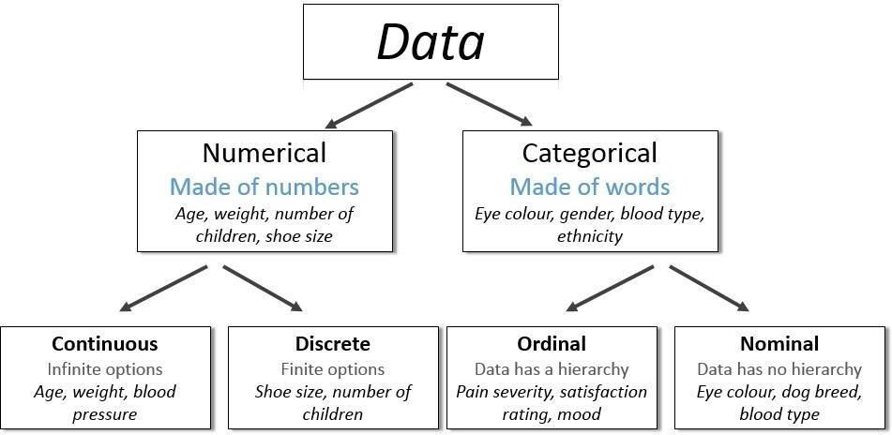

Slide 21
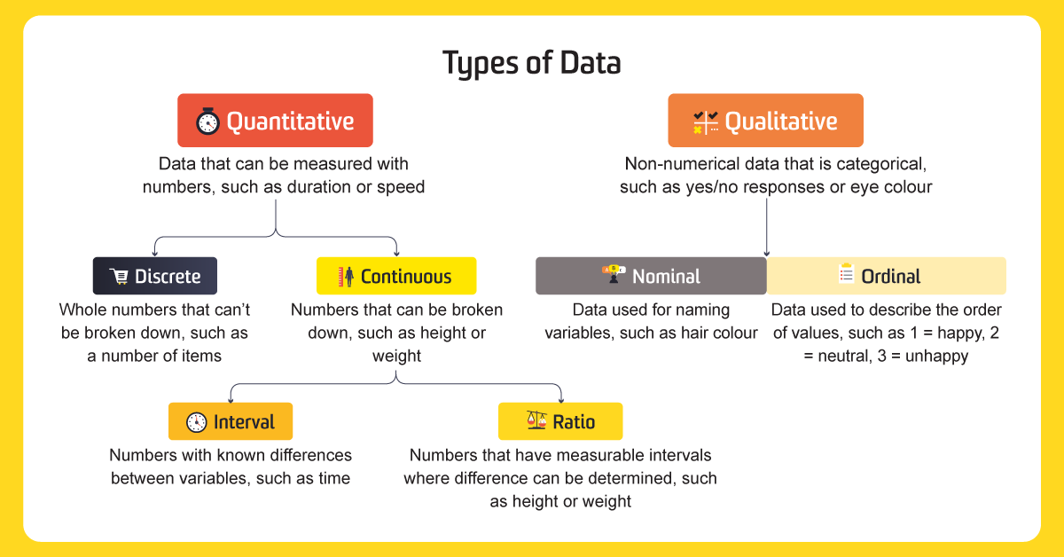

Slide 22
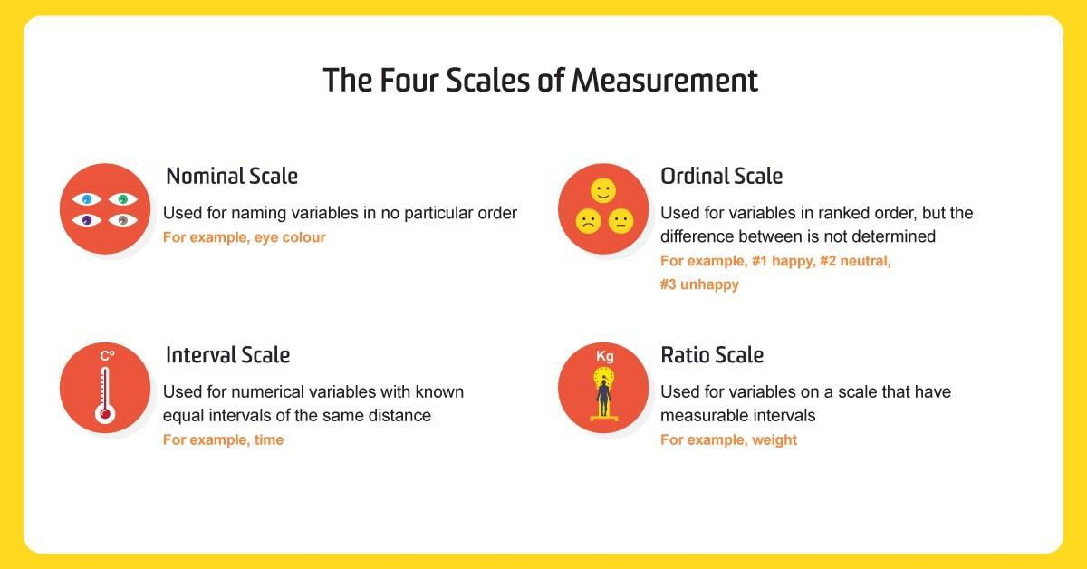

Slide 23
Nominal data
Data that represent categories or names.
There is no implied order to the categories of nominal data.
In these types of data, individuals are simply placed in the proper category or group, & the number in each category is counted.
Each item must fit into exactly one category.
Some other examples of nominal data:
Eye color - brown, black, etc.
Religion - Christianity, Islam, Hinduism, etc
Sex - male, female

Slide 24
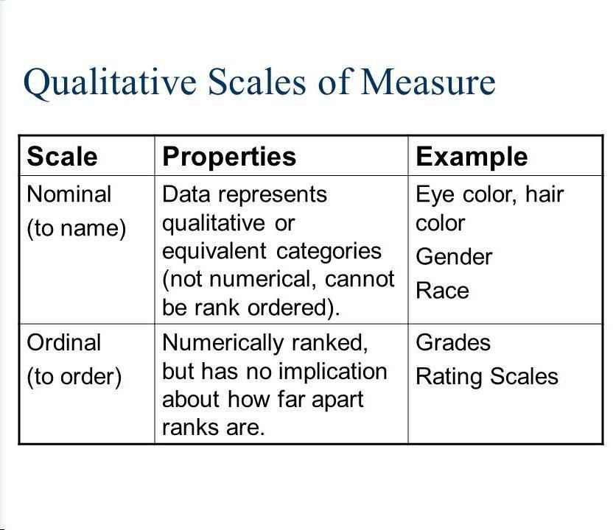

Slide 25
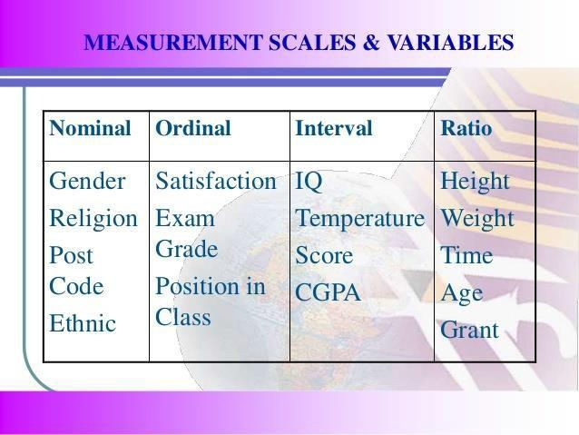

Slide 26
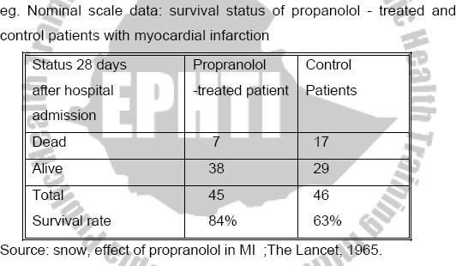

Slide 27
ORDINAL DATA:-
have order among the response classifications
(categories). The spaces or intervals between the categories are not necessarily equal.
Example:
strongly agree
agree
no opinion
disagree
strongly disagree
In the above situation, we only know that the data are ordered.

Slide 28
INTERVAL DATA
In interval data the intervals between values are the same.
For ex, in the Fahrenheit temperature scale, the difference between 70 degrees & 71 degrees is the same as the difference between 32 and 33 degrees.
But the scale is not a RATIO Scale.
40 degrees Fahrenheit is not twice as much as 20 degrees Fahrenheit.

Slide 29
RATIO DATA
The data values in ratio data do have meaningful ratios
For ex, age is a ratio data, some one who is 40 is twice as old as someone who is 20.

Slide 30
Numerical continuous
The scale with the greatest degree of quantification is a numerical continuous scale.
Each observation theoretically falls somewhere along a continuum.
One is not restricted, in principle, to particular values such as the integers of the discrete scale.
The restricting factor is the degree of accuracy of the measuring instrument most clinical measurements, such as blood pressure, serum cholesterol level, height, weight, age etc. are on a numerical continuous scale.

Slide 31
Classification by the number of variables
Univariate - data that describes a single characteristic of the population
Bivariate - data that describes two characteristics of the population
Multivariate - data that describes more than two characteristics (beyond the scope of this course

Slide 32
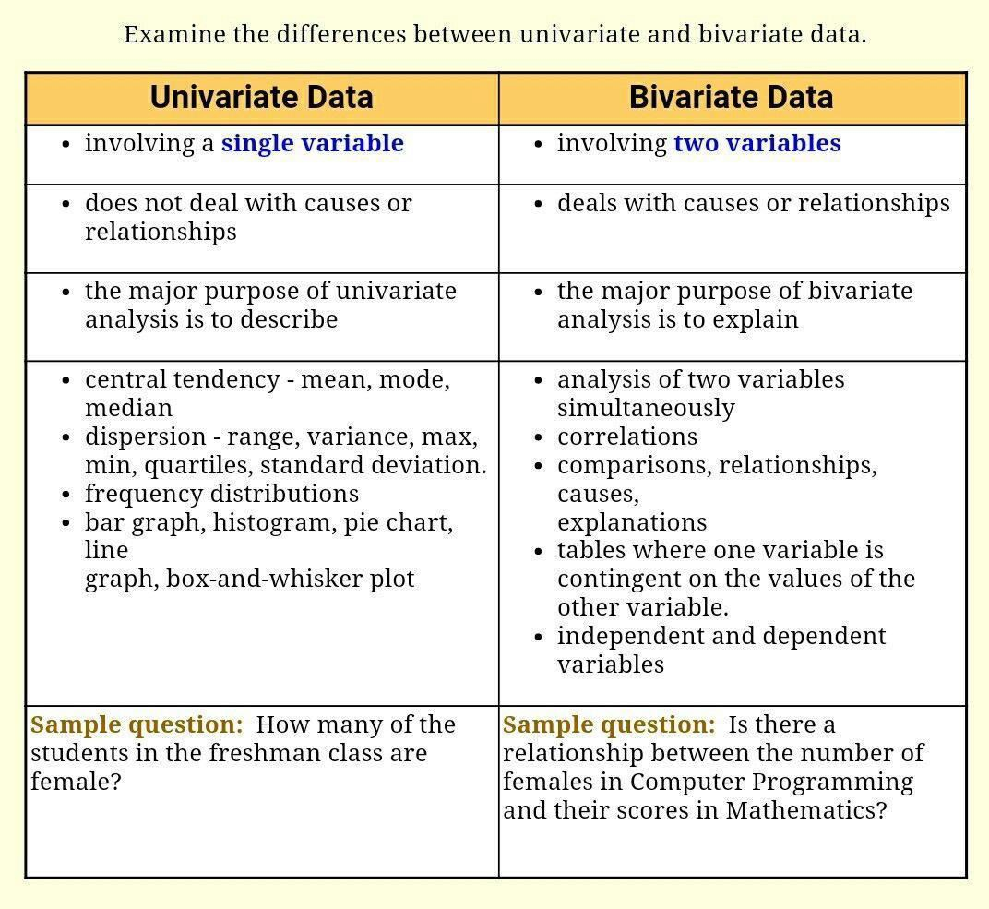

Slide 33
Identify the following variables:
the income of adults in your city
Numerical
the color of M&M candies selected at random from a
bag
Categorical
3. the number of speeding tickets each student in AP
Statistics has received
Numerical
the area code of an individual
Categorical
the birth weights of female babies born at a large
hospital over the course of a year
Numerical

Slide 34
Exercises
Identify the type of data (nominal, ordinal, interval and ratio) represented by each of the following. Confirm your answers by giving your own examples.
Blood group
Temperature (Celsius)
Ethnic group
Job satisfaction index (1-5)
Number of heart attacks
Calendar year
Serum uric acid (mg/100ml)
Number of accidents in 3 - year period
Number of cases of each reportable disease reported by a health worker
The average weight gain of 6 1-year old dogs (with a special diet supplement) was 950grams last month.

